Slide 1


<Name>
<Date>

Slide 2

Outline
Executive Summary
Introduction
Methodology
Results
Conclusion
Appendix

Slide 3
Executive Summary
Summary of methodologies
Data Collection through API
Data Collection with Web Scraping
Data Wrangling
Exploratory Data Analysis with SQL
Exploratory Data Analysis with Data Visualization
Interactive Visual Analytics with Folium
Machine Learning Prediction
Summary of all results
Exploratory Data Analysis result
Interactive analytics in screenshots
Predictive Analytics result

Slide 4
Introduction
Space X advertises Falcon 9 rocket launches on its website with a cost of 62 million dollars; other providers cost upward of 165 million dollars each, much of the savings is because Space X can reuse the first stage. Therefore, if we can determine if the first stage will land, we can determine the cost of a launch. This information can be used if an alternate company wants to bid against space X for a rocket launch.

Slide 5

Section 1

Slide 6
Methodology
Executive Summary
Data collection methodology:
Data was collected using SpaceX API and web scraping from Wikipedia.
Perform data wrangling
One-hot encoding was applied to categorical features
Perform exploratory data analysis (EDA) using visualization and SQL
Perform interactive visual analytics using Folium and Plotly Dash
Perform predictive analysis using classification models
SVM, Logistic Regression, Decision Tree, KNN

Slide 7
Flight No.', 'Date and time ( )', 'Launch site', 'Payload', 'Payload mass', 'Orbit', 'Customer', 'Launch outcome'
Data Collection
Data was collected from two sources:
- SpaceX API
- Wikipedia by using webscrapping methods
The first dataset has columns: BoosterVersion, PayloadMass, Orbit, LaunchSite, Outcome, Flights, GridFins, Reused, Legs, LandingPad, Block, ReusedCount, Serial, Longitude, Latitude
The second dataset has columns: Flight No, Date and Time, Launch Site, Payload Mass, Orbit, Customer, Launch Outcome

Slide 8
Data Collection – SpaceX API
request-get-parse
SpaceX launch data
Normalize/ to pandas df
data
rocket
payloads
launchpad
cores
launch_df
Remove Falcone1
https://github.com/rimmashilkina/IBM-Data-Science-Certification/blob/main/jupyter-labs-spacex-data-collection-api%20(1).ipynb
Data_falcon9

Slide 9
Data Collection - Scraping
https://github.com/rimmashilkina/IBM-Data-Science-Certification/blob/main/jupyter-labs-webscraping.ipynb
Wikipedia
get
response
Beautiful Soup
extract tables, extract columns names, fill with data
launch_dict
soup
Convert to pandas df
df

Slide 10
Data Wrangling
Several steps were performed:
Calculated the number of launches on each site
Calculated the number and occurrence of each orbit
Calculated the number and occurrence of mission outcome per orbit type
Created a landing outcome label from Outcome
https://github.com/rimmashilkina/IBM-Data-Science-Certification/blob/main/IBM-DS0321EN-SkillsNetwork_labs_module_1_L3_labs-jupyter-spacex-data_wrangling_jupyterlite.jupyterlite.ipynb

Slide 11
EDA with Data Visualization
Several charts were used:
Catplot() and relplot() - to show relationships between pairs of variables
barchart – to show rate of categorical variable
lineplot() – to show yearly trend
https://github.com/rimmashilkina/IBM-Data-Science-Certification/blob/main/IBM-DS0321EN-SkillsNetwork_labs_module_2_jupyter-labs-eda-dataviz.ipynb.jupyterlite.ipynb

Slide 12
EDA with SQL
Displaying the names of the unique launch sites in the space mission
Displaying5 records where launch sites begin with the string 'CCA'
Displaying the total payload mass carried by boosters launched by NASA (CRS)
Displaying average payload mass carried by booster version F9 v1.1
Listing the date when the first successful landing outcome in ground pad was achieved
Listing the names of the boosters which have success in drone ship and have payload mass greater than 4000 but less than 6000
Listing the total number of successful and failure mission outcomes
Listing the names of the booster_versions which have carried the maximum payload mass by using a subquery
Listing the records which will display the month names, failure landing_outcomes in drone ship ,booster versions, launch_site for the months in year 2015
Ranking the count of landing outcomes (such as Failure (drone ship) or Success (ground pad)) between the date 2010-06-04 and 2017-03-20, in descending order.
https://github.com/rimmashilkina/IBM-Data-Science-Certification/blob/main/jupyter-labs-eda-sql-coursera_sqllite.ipynb
Add the GitHub URL of your completed EDA with SQL notebook, as an external reference and peer-review purpose

Slide 13
Build an Interactive Map with Folium
Markers with circle, Pop up Labels and Text Labels for:
NASA Johnson Space Center – to show start location
All Launch sites – to show their geographical location and proximity to Equator and coasts
Latitude and Longitude coordinates were used.
https://github.com/rimmashilkina/IBM-Data-Science-Certification/blob/main/IBM-DS0321EN-SkillsNetwork_labs_module_3_lab_jupyter_launch_site_location.jupyterlite.ipynb

Slide 14
Build a Dashboard with Plotly Dash
Dropdown list for Launch sites selection
Pie chart to show success lunches for all/each LaunchSite(s)
Slider – to select Payload Mass range
Scatter chart – to show correlation between Payload Mass and Success Rate for the different Booster Versions
https://github.com/rimmashilkina/IBM-Data-Science-Certification/blob/main/spacex_dash_app.py

Slide 15

Predictive Analysis (Classification)
NumPy array from Class variable
Standardizing and transforming data
Split data into train and test datasets
Build Logistic Regression with best parameters, find accuracy
Find the best performed method
Build KNN model with best parameters, find accuracy
Build Tree model with best parameters, find acciracy
Build SVM model with best parameters, find accuracy
https://github.com/rimmashilkina/IBM-Data-Science-Certification/blob/main/IBM-DS0321EN-SkillsNetwork_labs_module_4_SpaceX_Machine_Learning_Prediction_Part_5.jupyterlite.ipynb

Slide 16
Results
Exploratory data analysis results
Interactive analytics demo in screenshots
Predictive analysis results

Slide 17

Section 2

Slide 18
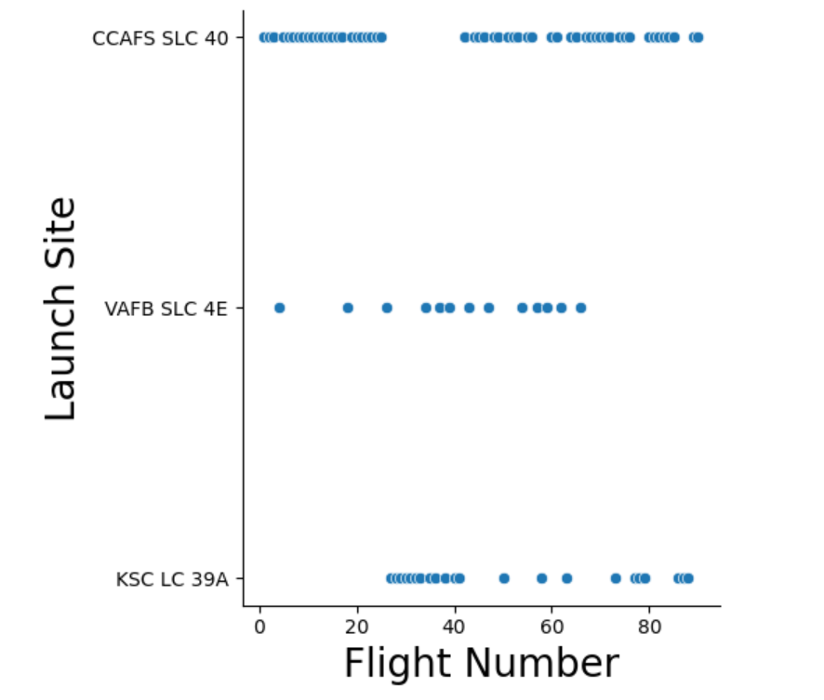
Flight Number vs. Launch Site
Most of the launches are from site CCAFS SLC 40
There is period when most launches were from LSC LC 39A site. It might be due to some construction or repair work on CCAFS SLC 40 site.

Slide 19
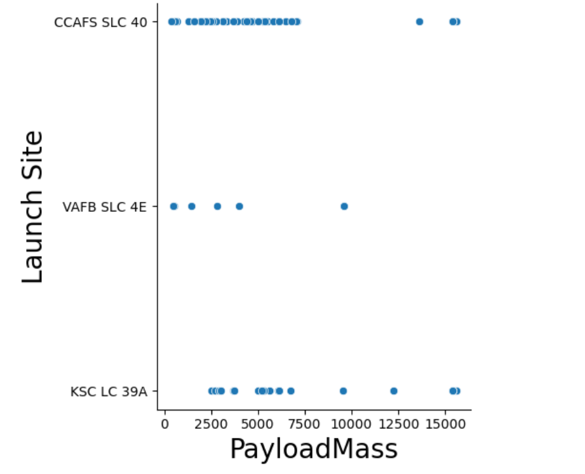
Payload vs. Launch Site
Sites CCAFS SLC 40 and KSC LC 39A are used for any payload type, while VAFB SLC 4E is used for payloads up to 10000.
Most payloads are less than 7500

Slide 20
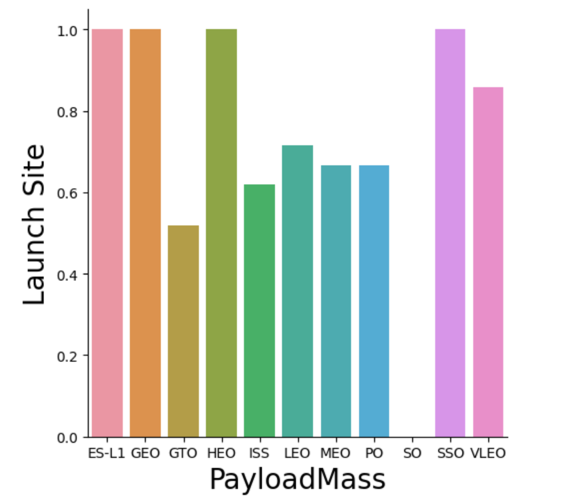
Success Rate vs. Orbit Type
Orbits ES-L1, GEO, HEO, and SSO has 100% success rate.
Orbit SO has 0 successful attempts
For other orbits success rate is more than 50%

Slide 21
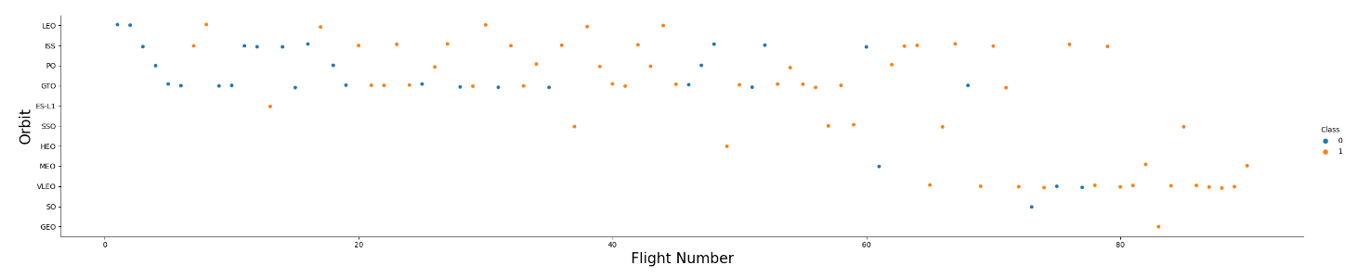
Flight Number vs. Orbit Type
For LEO orbit there were few unsuccessful flights at the beginning, but later starts were all successful
For GTO orbit there is a pattern of constant flips between successful and unsuccessful starts.

Slide 22
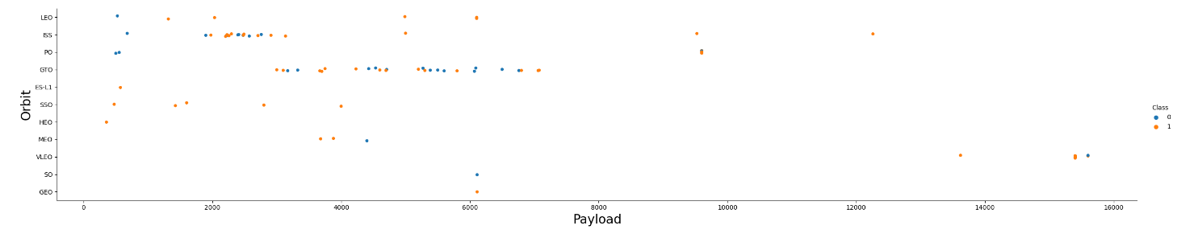
Payload vs. Orbit Type
Heavier payloads provide negative impact on GTO orbit
For LEO and ISS orbits heavy payloads increase success rate.

Slide 23
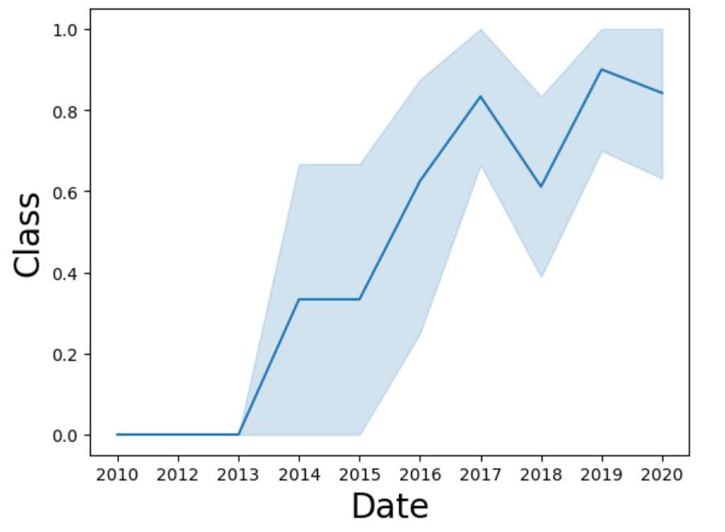
Launch Success Yearly Trend
Success rate increases since 2013.
There are some decreases in 2018 and 2020

Slide 24
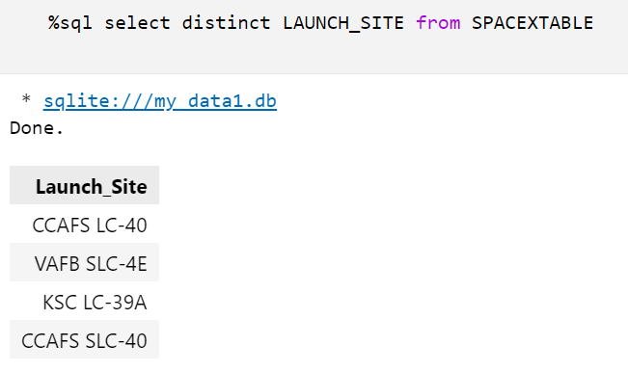
All Launch Site Names
Showing launch sites names

Slide 25
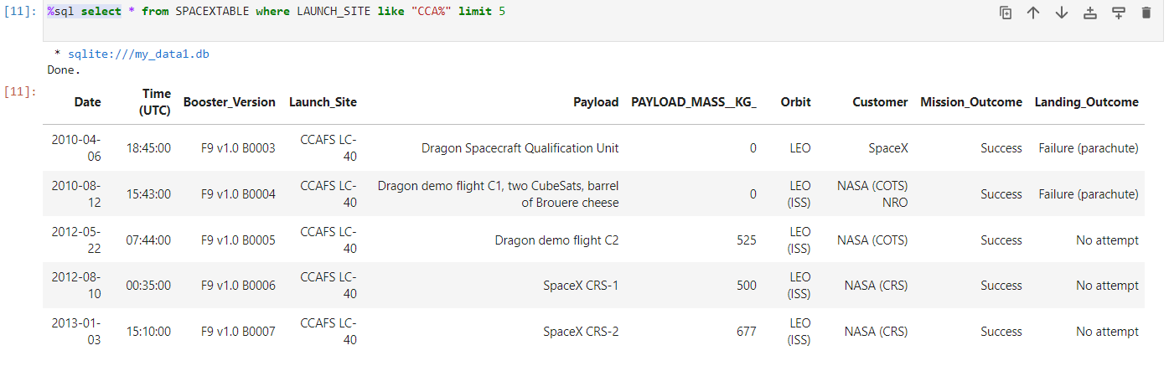
Launch Site Names Begin with 'CCA'

Slide 26
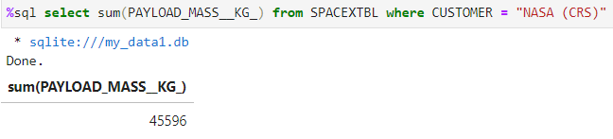
Total Payload Mass

Slide 27
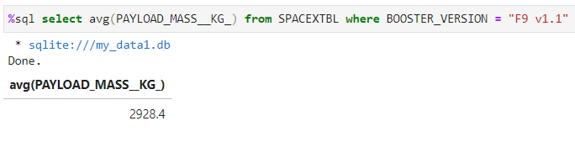
Average Payload Mass by F9 v1.1

Slide 28
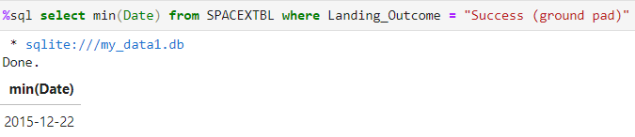
First Successful Ground Landing Date

Slide 29
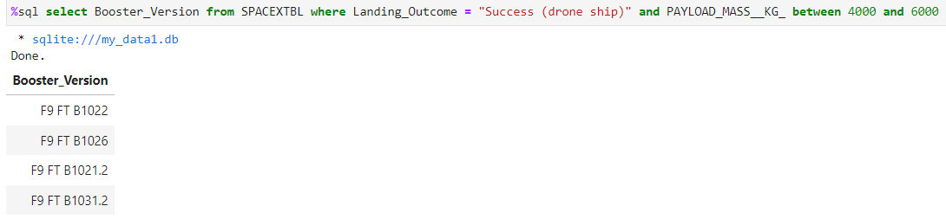
Successful Drone Ship Landing with Payload between 4000 and 6000

Slide 30
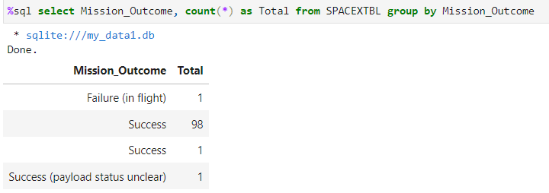
Total Number of Successful and Failure Mission Outcomes

Slide 31
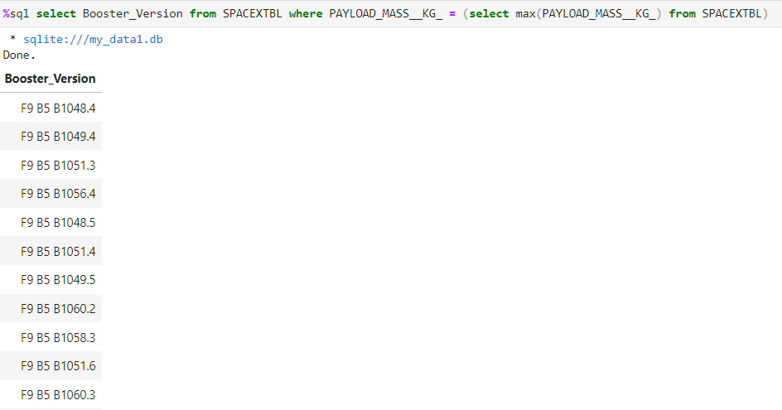
Boosters Carried Maximum Payload

Slide 32
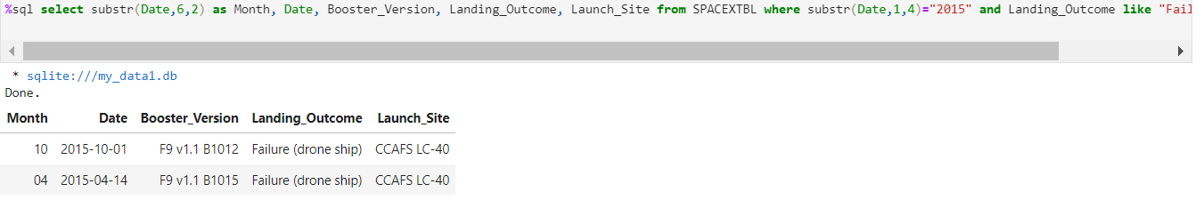
2015 Launch Records

Slide 33
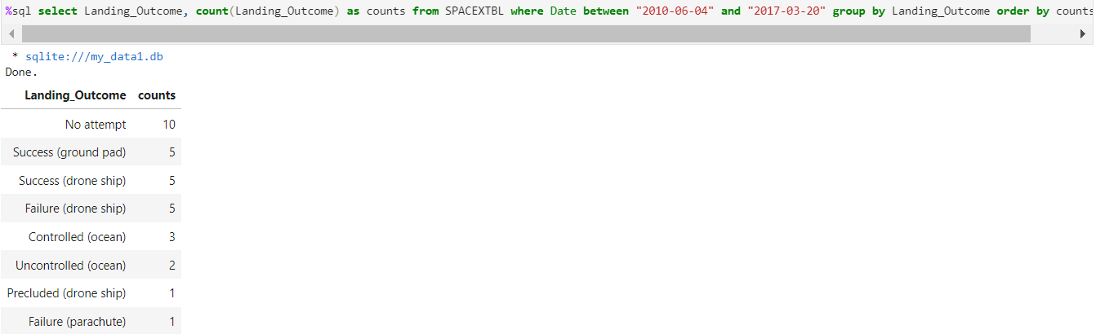
Rank Landing Outcomes Between 2010-06-04 and 2017-03-20

Slide 34

Section 3

Slide 35
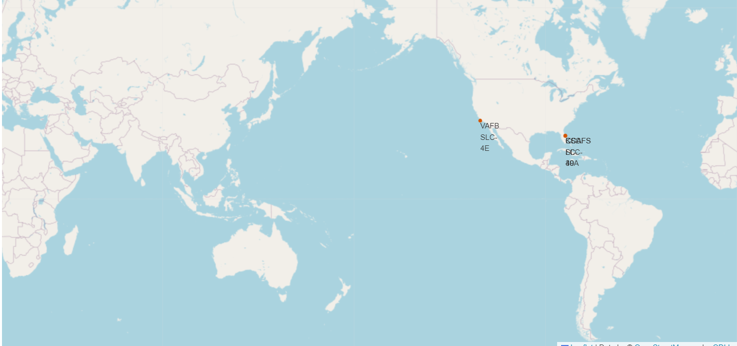
SpaceX Launch Sites Locations

Slide 36
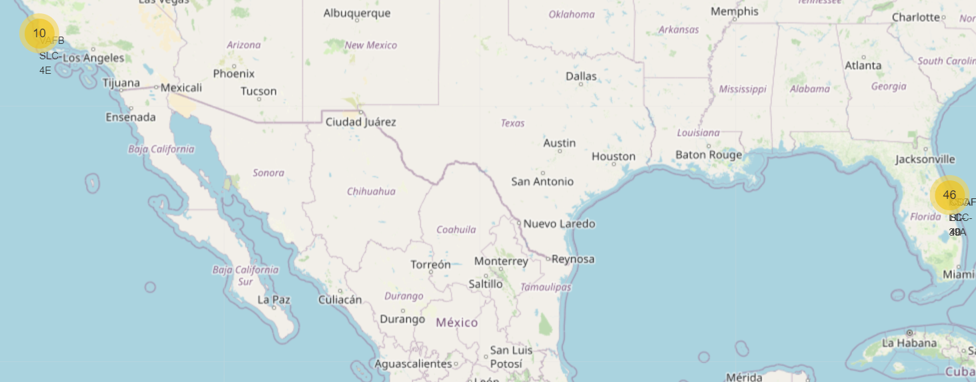
Success and Failed Launches of SpaceX

Slide 37
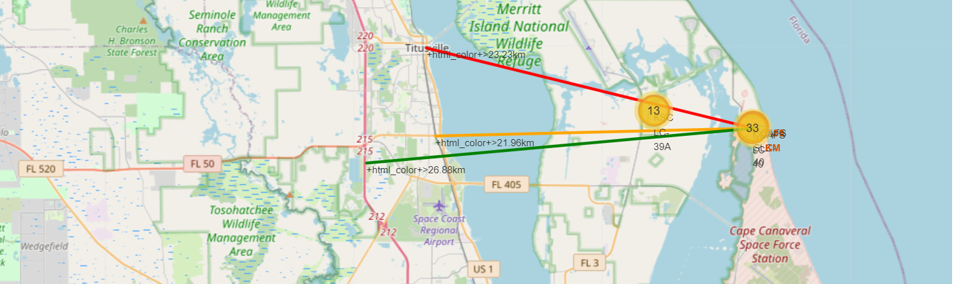
Calculating distances between Launch site and its proximities

Slide 38

Section 4

Slide 39
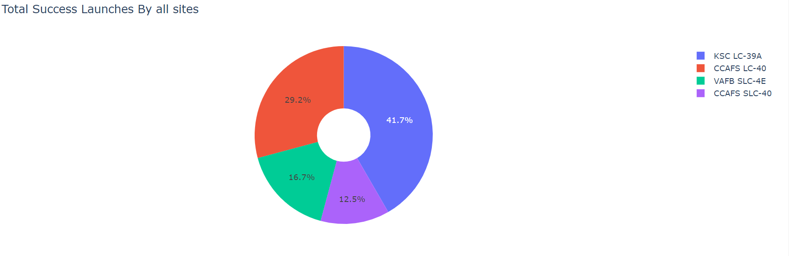
Total Success Launches by All Sites

Slide 40
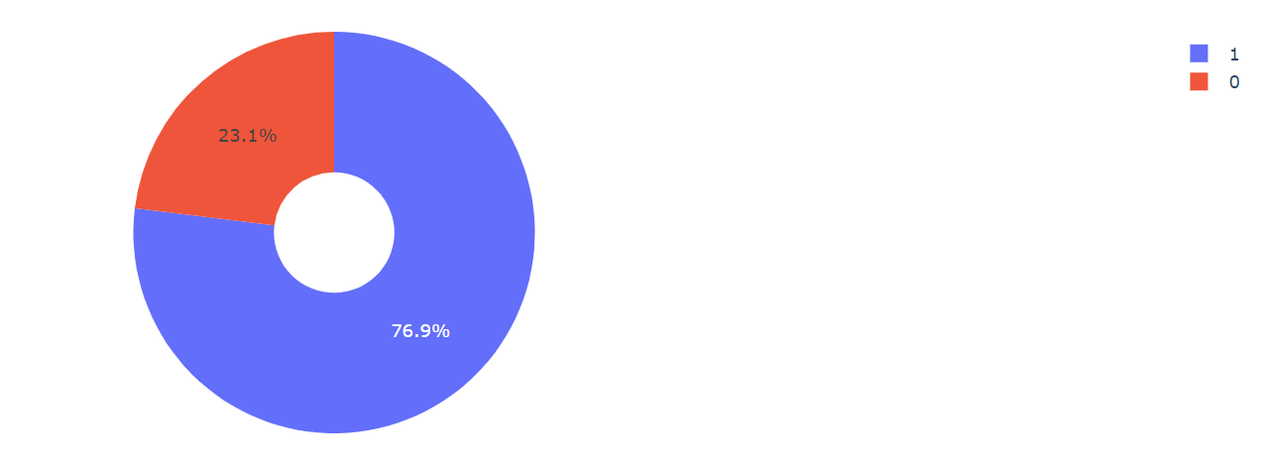
Total Success Launches for Site KSC LC-39A

Slide 41
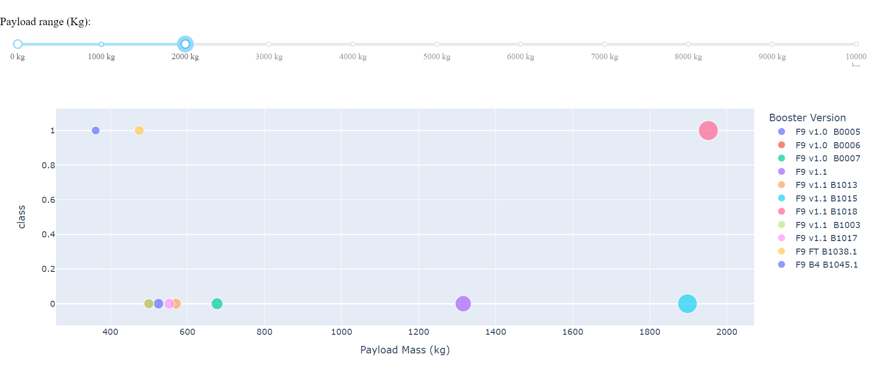
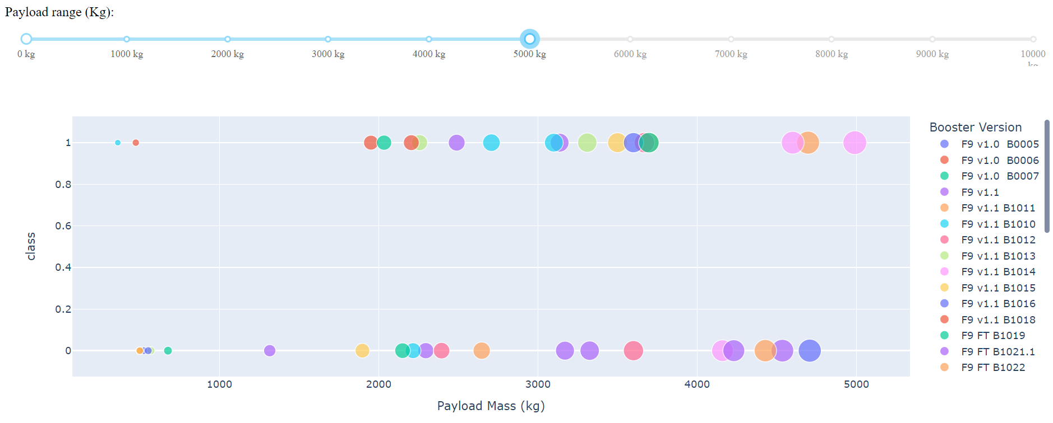
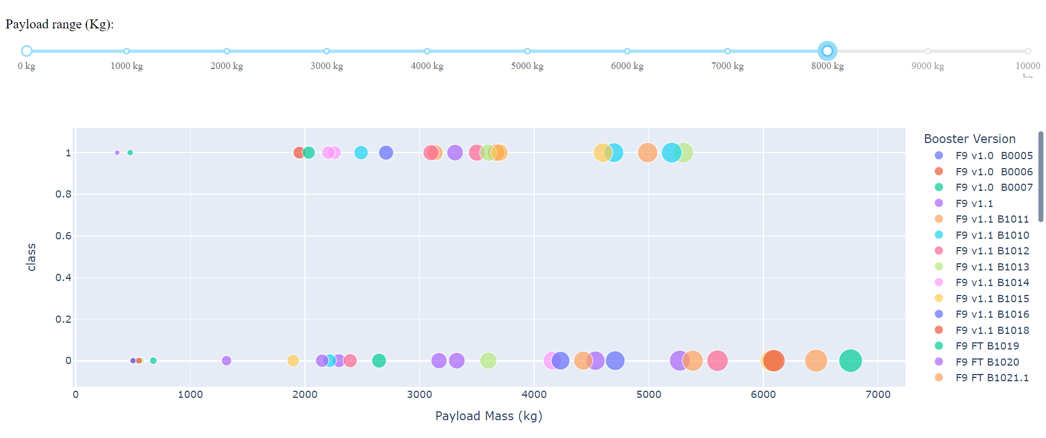
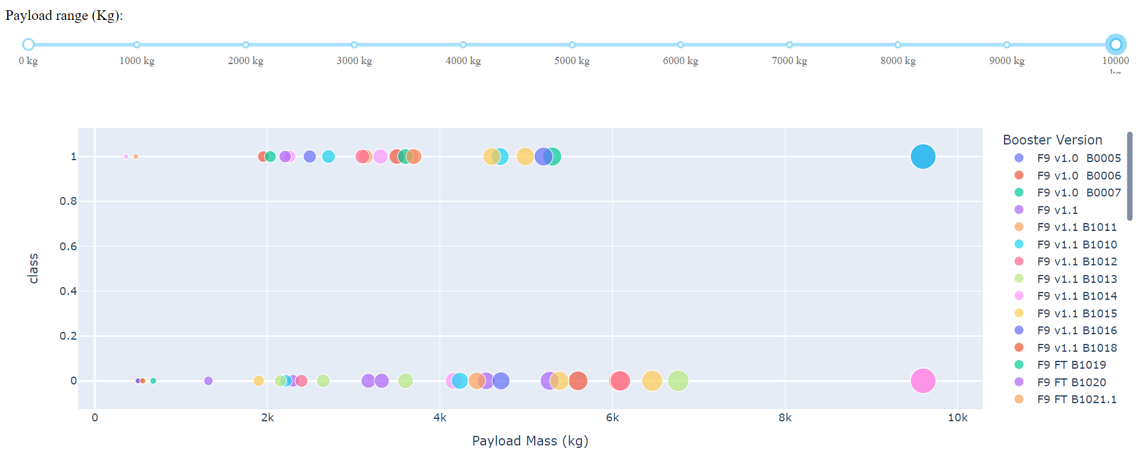
Correlation of Payload to Mission Outcome

Slide 42

Section 5

Slide 43
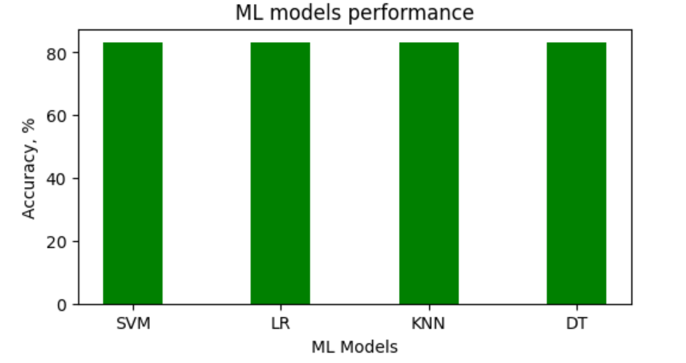
Classification Accuracy

Slide 44
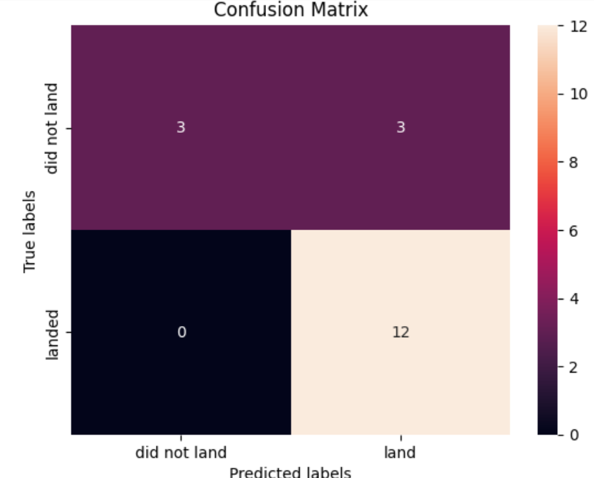
Confusion Matrix

Slide 45
Conclusions
Several points should be considered by an alternate company:
Orbits: most success – ES-L1, GEO, HEO
Launch Site KSC LC-39A is the most successful
Lunch success rate increasing since 2013
More launches from a site gives better success rate
The best ML model to work with these Datasets is Decision Tree

Slide 46


